Slide 1
Digital design of food manufacturing processes – theory and applications
Modernizing Agricultural Practice using Internet of Things
MAPIoT Summer School in Norway
24.07.2022 – 07.08.2022
Melsom High School, Sandefjord
organized by University of South-Eastern Norway
Assoc. Prof. PhD. Ion Dan Mironescu
ULBS
¹) The digital materials do not reflect the views of Financial Mechanism Office (FMO), and they do not purport to be representative of the countries, regions and themes they illustrate. The use of the materials does not imply endorsement by the FMO, the Donor States, the Beneficiary States, or any other stakeholder of the EEA and Norway Grants. The FMO is not liable for any law infringements by third parties in the context of the operation and use of the media library.

Slide 2
Overview
Introduction to modeling and simulation using Petri Nets | Basic elements: places, transitions , arcs Simulation Modeling concurrency Timed nets Determinism vs stochastic Special arcs
Introduction to modelling and simulation of food manufacturing processes | Modeling processing equipment Modeling transport equipment Modeling control Modeling robots Modeling human operators Modeling a complete manufacturing line Simulating a complete manufacturing line
Introduction to digital design manufacturing processes | Designing the layout Designing the operation of the line Designing the command and control system

Slide 3
1. Introduction to modeling and simulation using Petri Nets

Slide 4
Modelling and simulation
Model - simplified representation of reality
Simulation – uses the model to predict how parts of/ real world evolve
Mathematical models
  Continous time models
    Partial Differential Equation (PDE) from sciences (physics, chemistry, biology)
    Change is continous in time
  Discret event models
    Change only at discret points in time (e.g Petri nets)

Slide 5
TINA (TIme petri Net Analyzer Toolbox
Toolbox hompage with news, tutorials and software
    https://projects.laas.fr/tina/papers.php
Download software from
    https://projects.laas.fr/tina/binaries/tina-3.7.0-amd64-mswin.zip
Unzip in an appropiate directory
Start (with) the visual editor simulator nd.exe located in the bin subdirectory

Slide 6
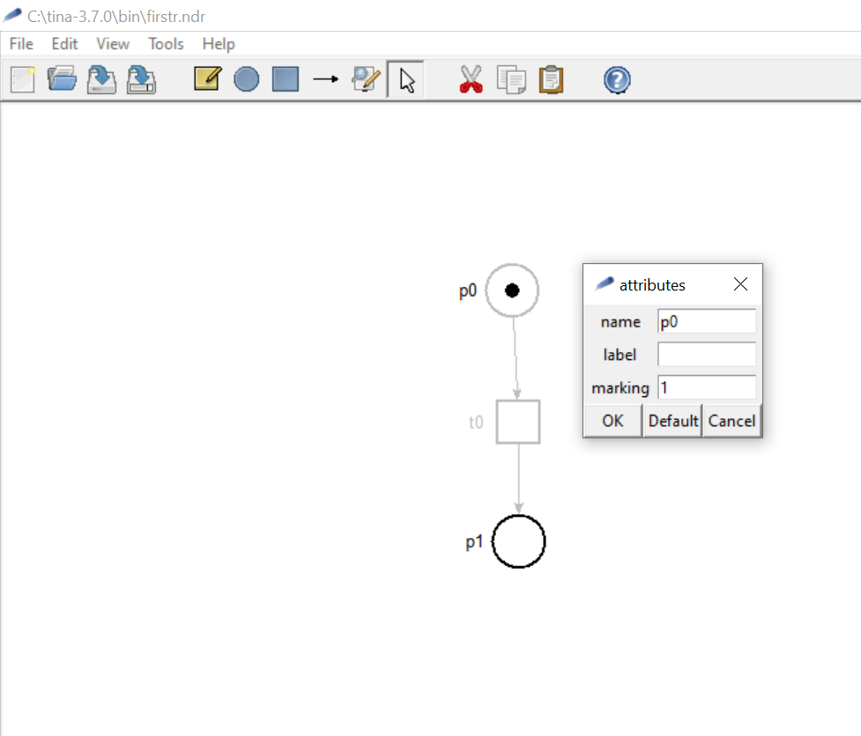
Basic elements: places, transitions , arcs
Place
tool
Transition
tool
Arc
tool
Selection
tool
Token
Place
Place attributes
Arc
Transition

Slide 7
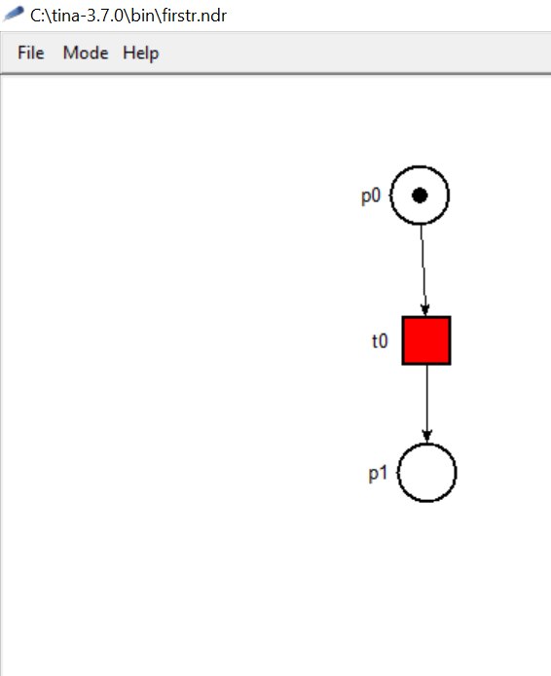
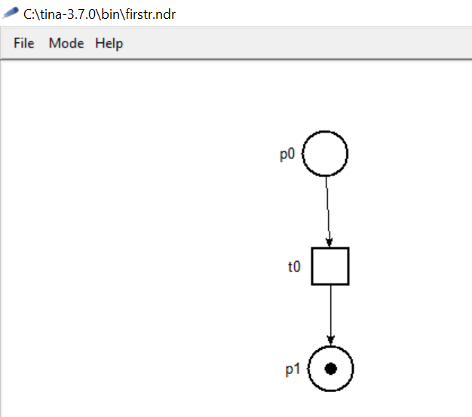
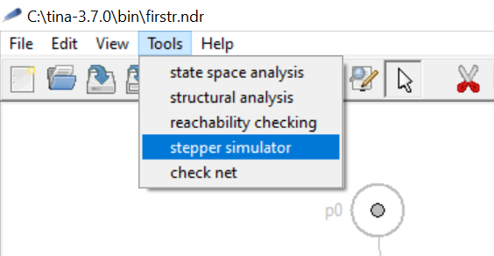
Simulation
Active transition – the input places contain a number of token greater or equal to the weights of the ingoing arcs
Input place – pre conditions
Ingoing arc
Outgoing arc
Simulation tool
By clicking on a active transition – the transition fires
A number of token equal to the weight of the ingoing arc (1) is subtracted from the input places.
A number of token equal to the weight of the outgoing arc (1) is added to the output places.
Output place -
If no transition is active, the system has reached his final (dead) state

Slide 8
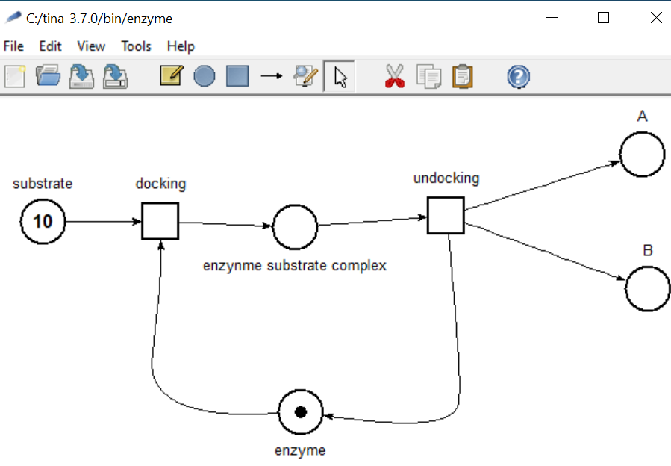
Simple model – enzymatic reaction

Slide 9
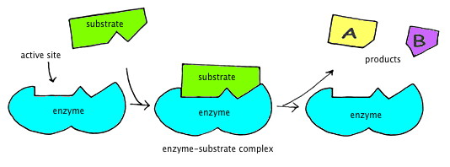
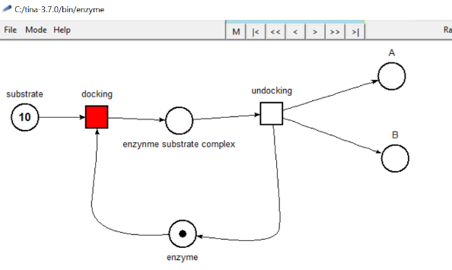
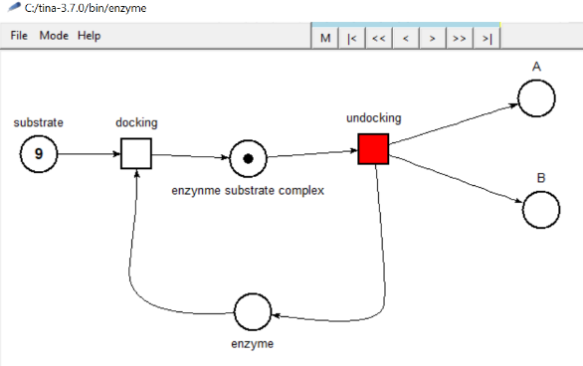
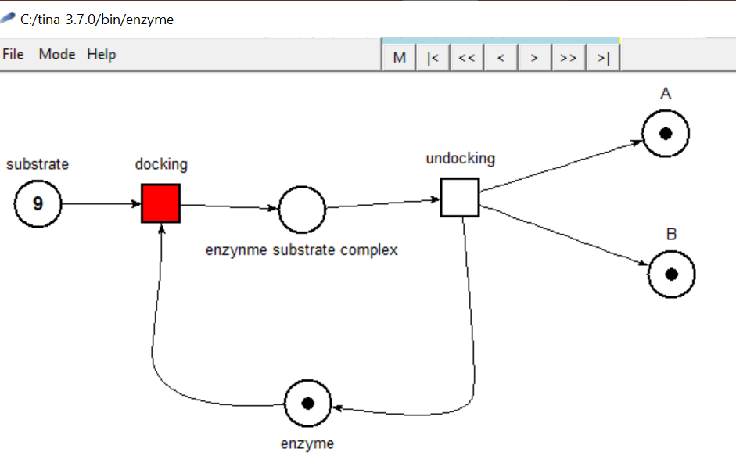
Simple model – simulation

Slide 10
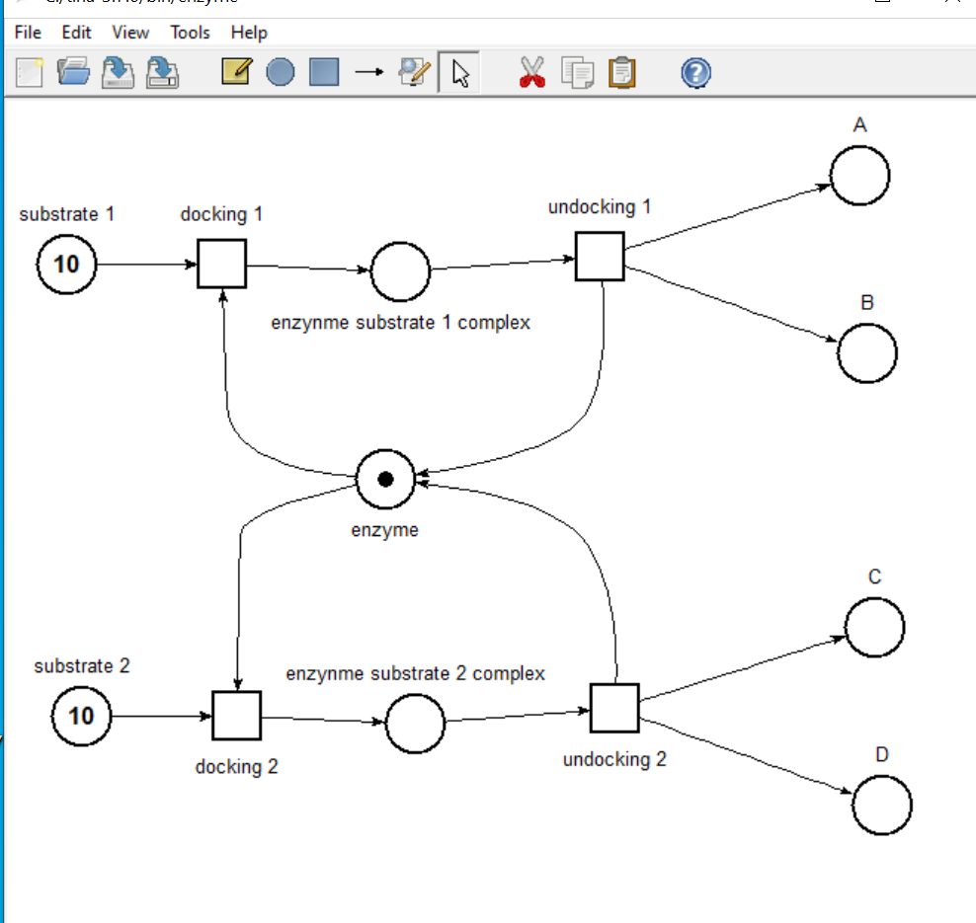
Modeling concurrency
Two substrates can interact with the same enzyme – they compete for the active site

Slide 11
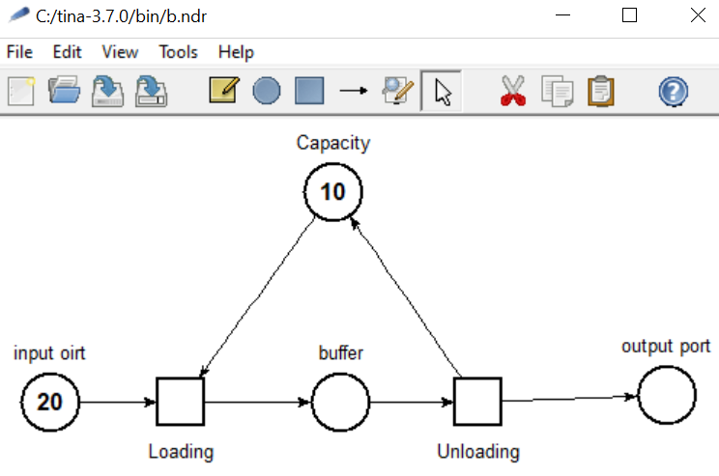
Buffer with limited capacity

Slide 12
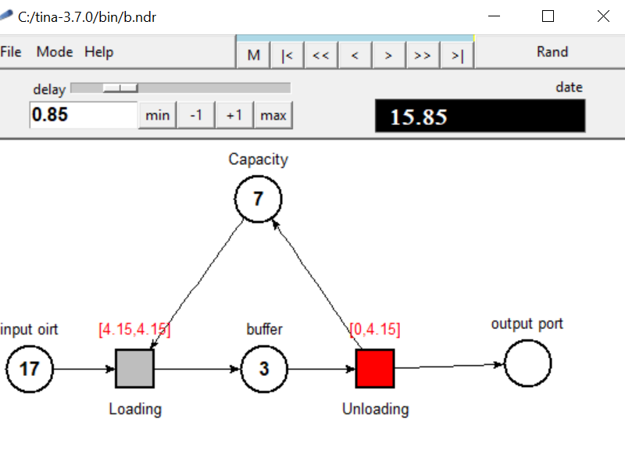
Timed nets
Manual selection of the next firing time
Current simulation time
Time to next firing – deterministic – if the transition remains active, it will fire in 4,15 time units
Time to next firing – stochastic – if the transition can fire now or at any time shorter then 4,15 time units

Slide 13
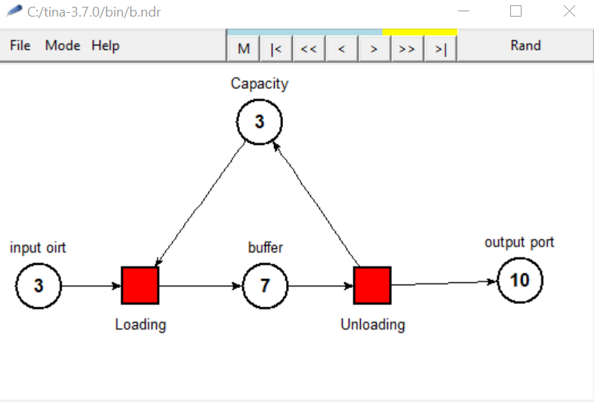
Determinism vs stochastic
The player menu can be used to start, stop, rewind, replay step by step any current simulation
By runing the automatic simulation a non deterministic simulation can be performed – if two or more transition are active simultaneously the program selects randomly which is fired - the order of firing is not preserved
By manualy firing the transition, a deterministic simulation can be performed – maintaining the same order of firing each time
port

Slide 14
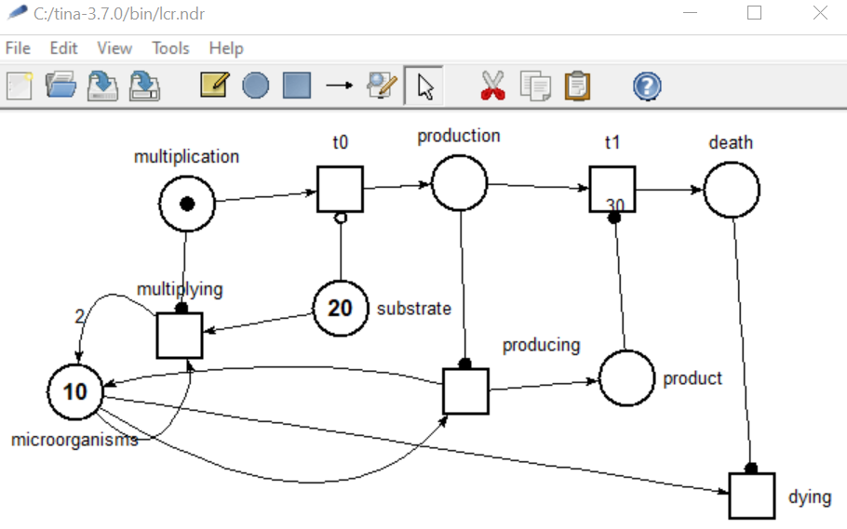
Special arcs - Life cycle example
The net models a microorganism population through its lifecycle
Read arc the transition is active as long as the place contains tokens
The upper part contains the phases of the lifecycle – each phase controls the processes that are specific
The lower part contains the model of real entities –microorganisms/ substrate/ products
Inhibitor arc - the transition is inhibiated as long as the place contains tokens

Slide 15
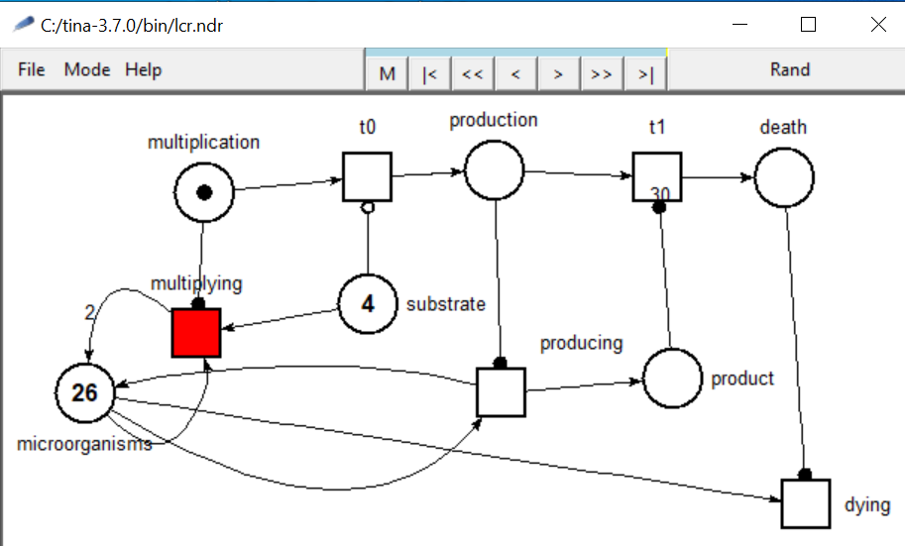
Multiplication phase
As long as the token is marking the multiplication phase, the multiplying transition is active and the nicroorganism consumes substrate and divide

Slide 16
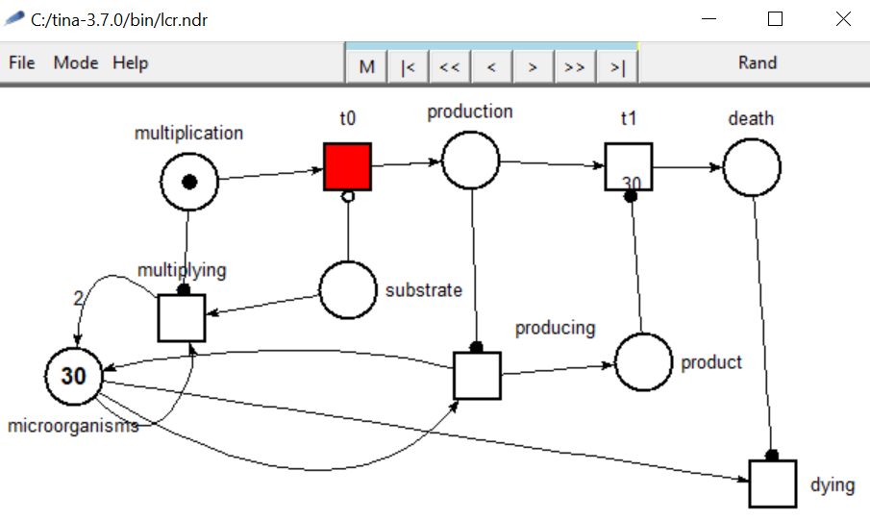
Transition to production phase
When no substrate token are available, the transition t0 to the production phases is activated

Slide 17
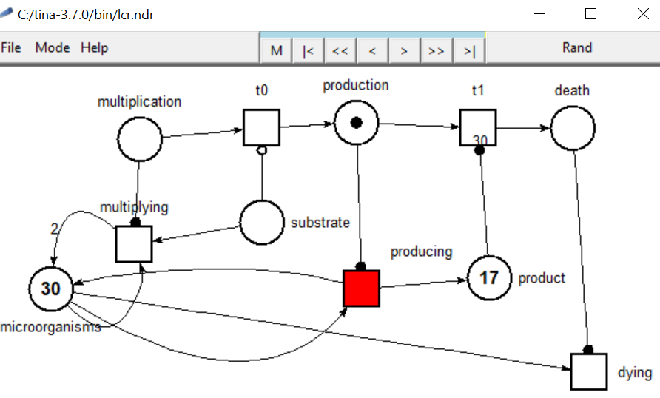
Production phase
In the production phase, the producing transition is activated and product tokens are generated

Slide 18
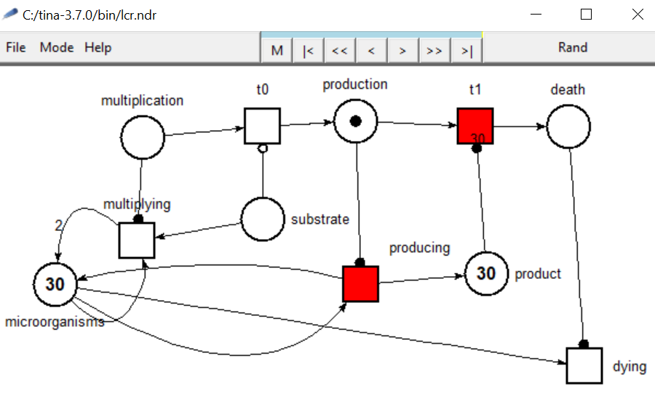
Transition to death phase
As the number of product token reaches an fixed threshold (30) the transition t1 to death phase is activated

Slide 19
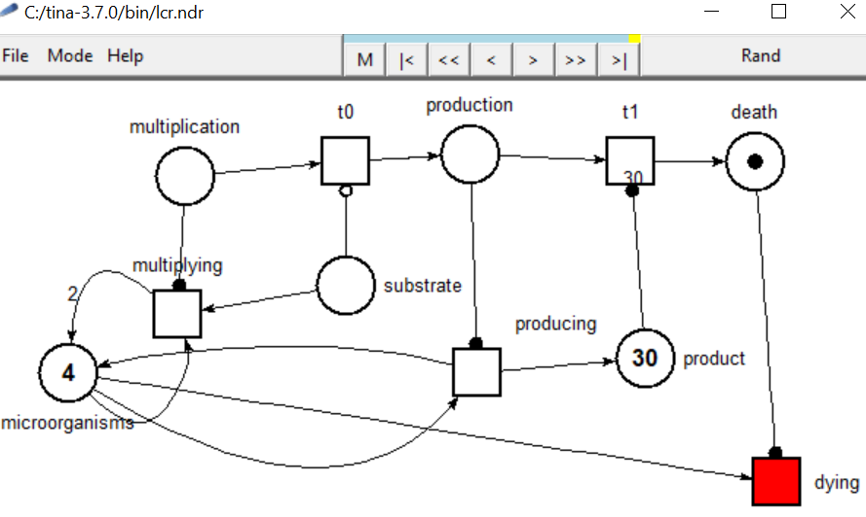
Death phase
In the death phase, the tokens from the microorganism place are removed by the dying transition

Slide 20
2. Introduction to modelling and simulation of food manufacturing processes

Slide 21
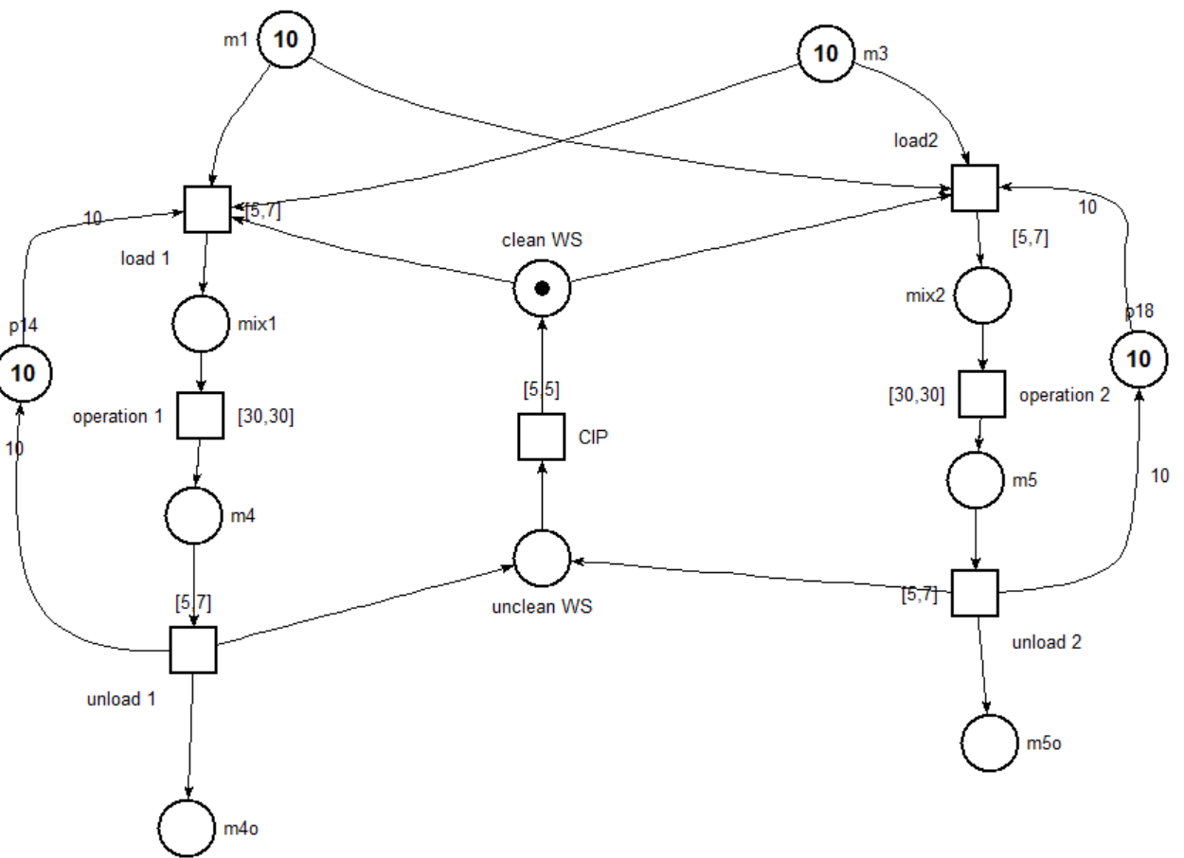
Modeling processing equipment

Slide 22
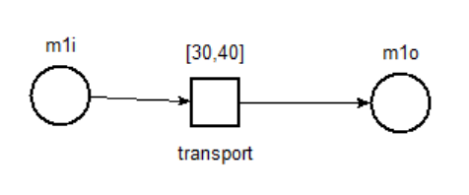
Modeling transport equipment
Belts, pipes, conveyors
Manipulator arms
AVG

Slide 23
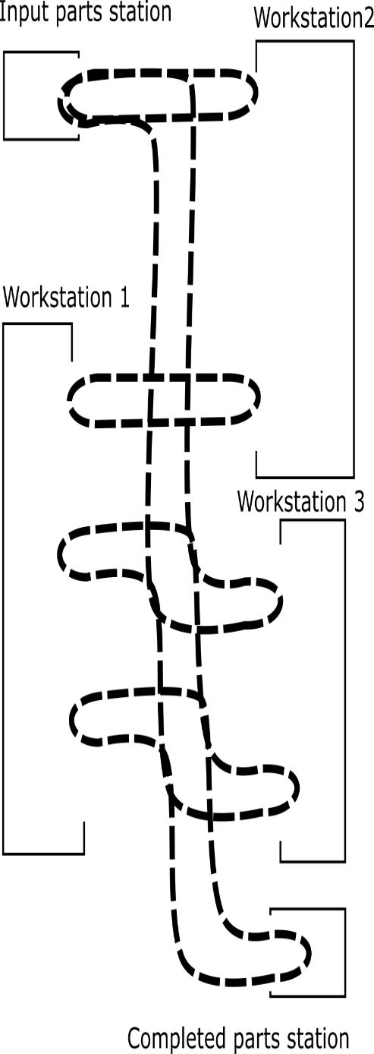
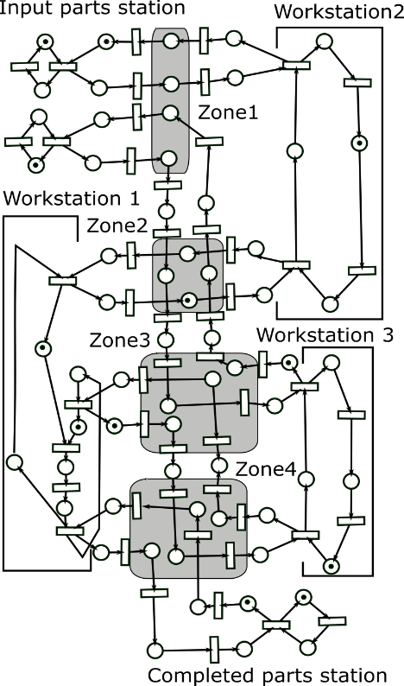
AVG

Slide 24
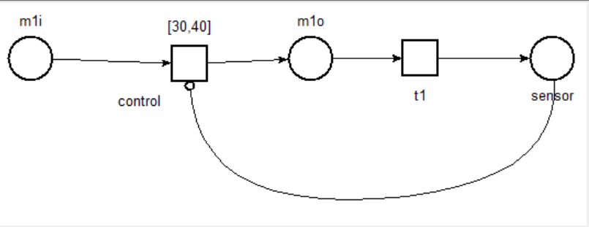
Modeling control
Control loop
  sensors – observable outputs - sensor places
  control unit
  efectors/enablers – controlable inputs – control places or control transitions

Slide 25
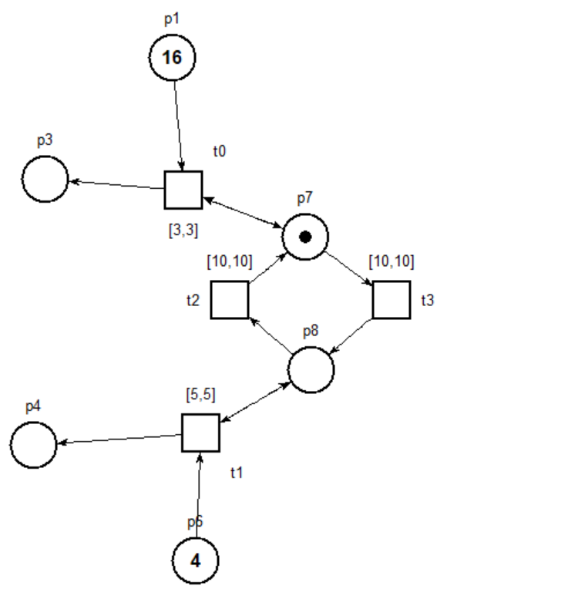
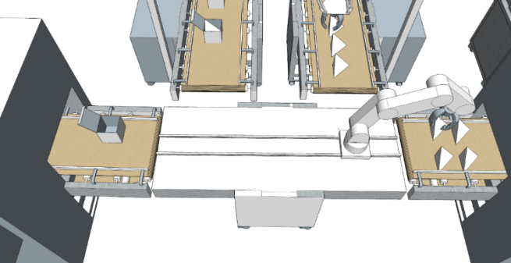
Modeling robots

Slide 26
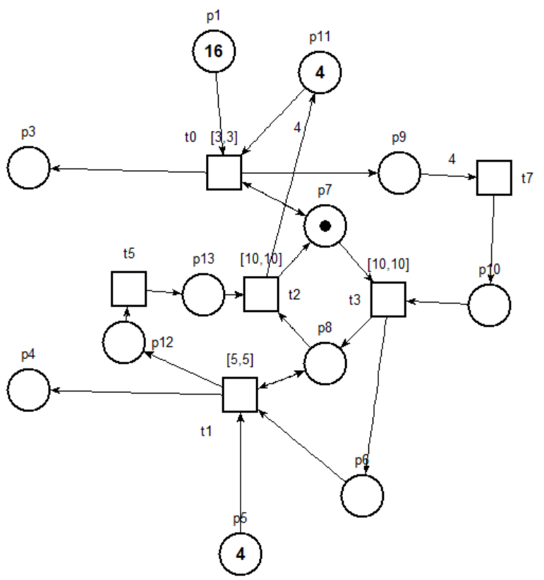
Robotic arm automation

Slide 27
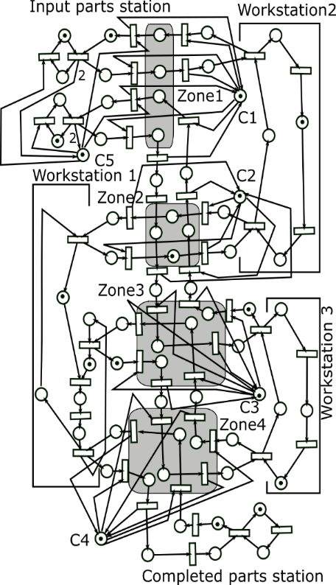
AVG automatisation
Ion Mironescu, ULBS ©

Slide 28
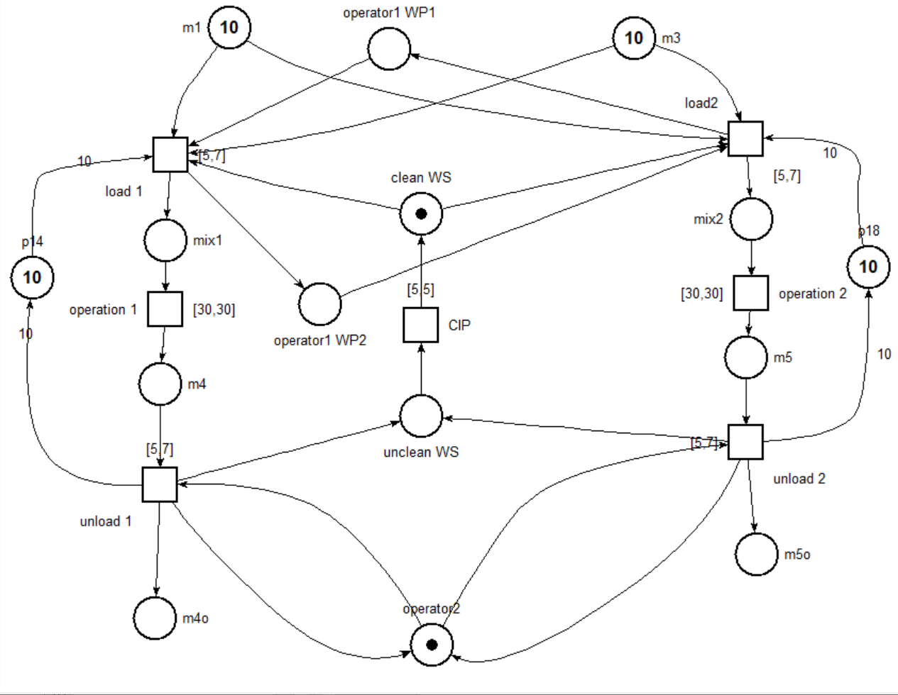
Modeling human operators

Slide 29
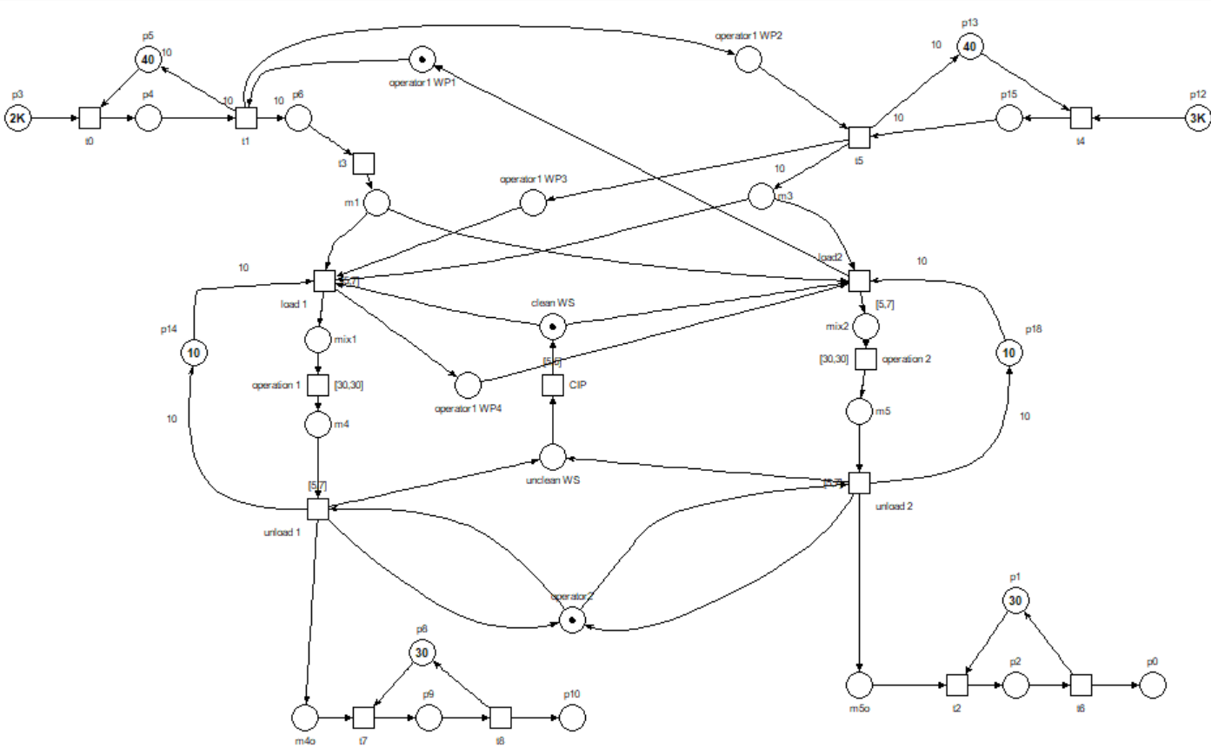
Modeling a complete manufacturing line

Slide 30
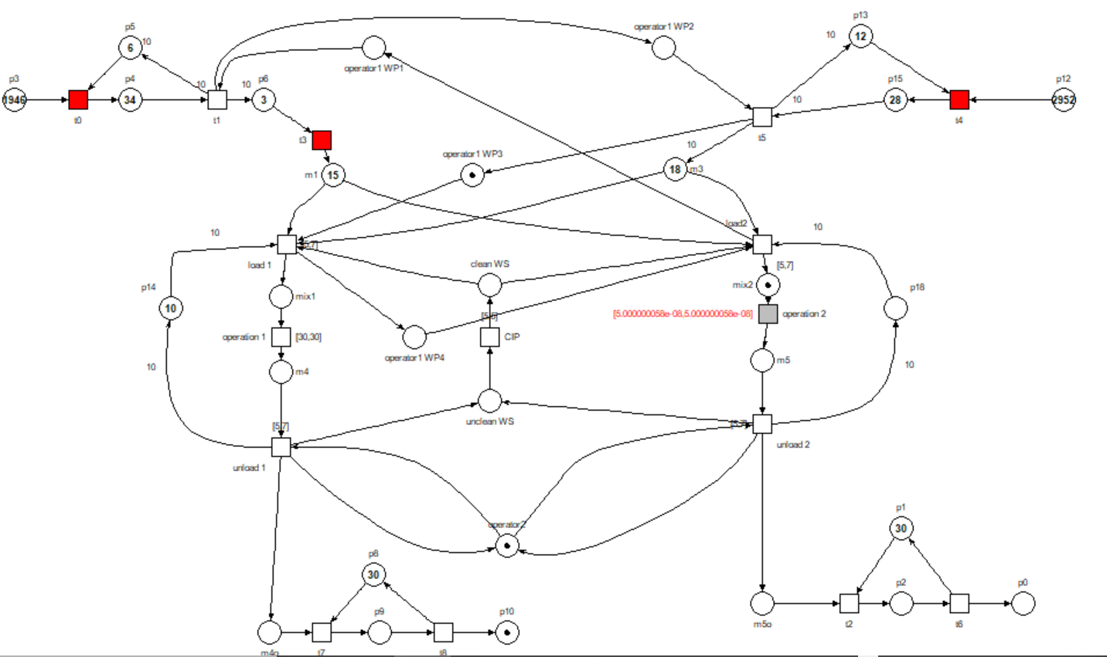
Simulating a complete manufacturing line

Slide 31
3. Introduction to digital design manufacturing processes

Slide 32
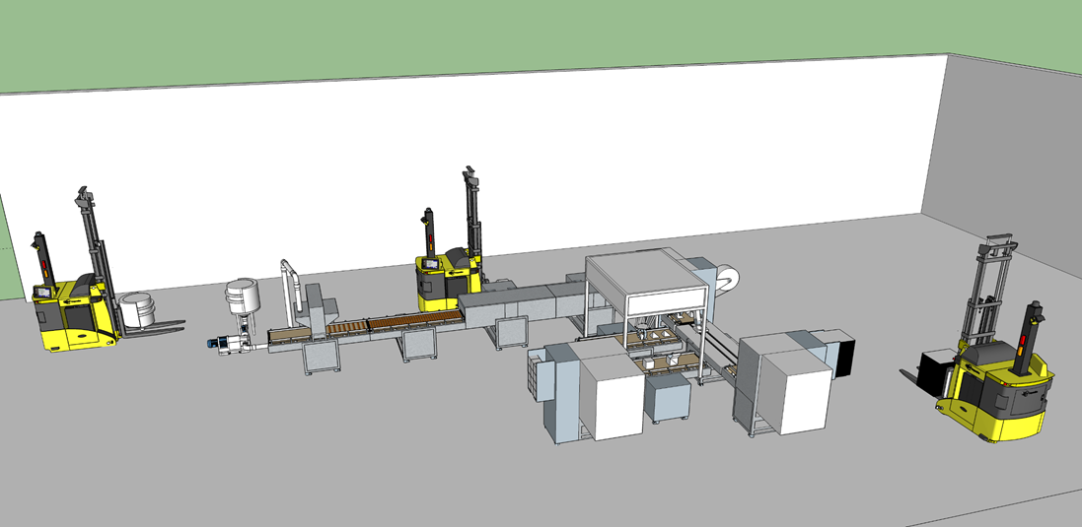
Line layout

Slide 33
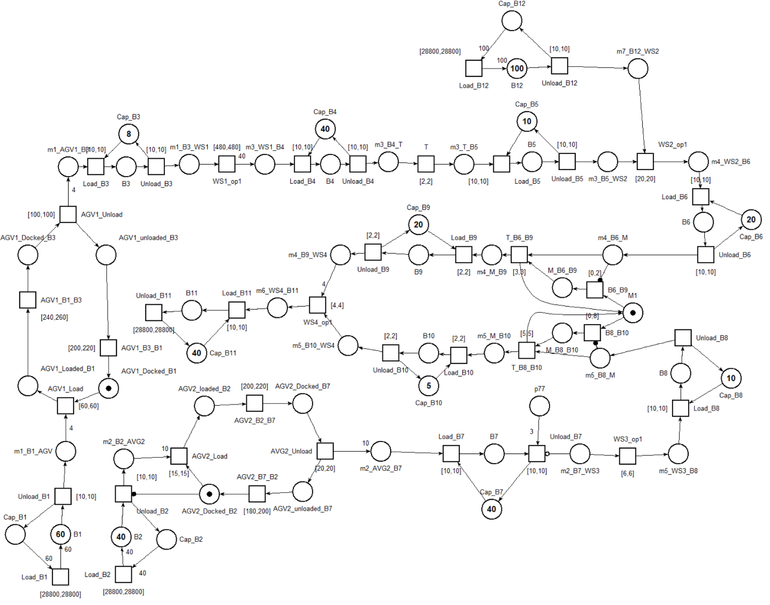
Petri net model of the line

Slide 34
Designing the operation of the line - Scheduling
Optimization problem represented by a triple α | β | γ
  α The design of the resources
  β The running properties and constraints
  γ The target function to be maximised or minimised - a combination (weighted sum) of completion time C_{j}, flow time F_{j}, Lateness L_{j} Throughput U_{j}, Tardiness T_{j}, Earlisness E_{j}
is an NP problem for m>2
Intensive researched domain
need intensive mathematical support for solving
But
- modeling can qualitatively help understand and classify the scheduling problem (α | β | γ )
- simulation can qualitatively and quantitatively validates the results and algorithms

Slide 35
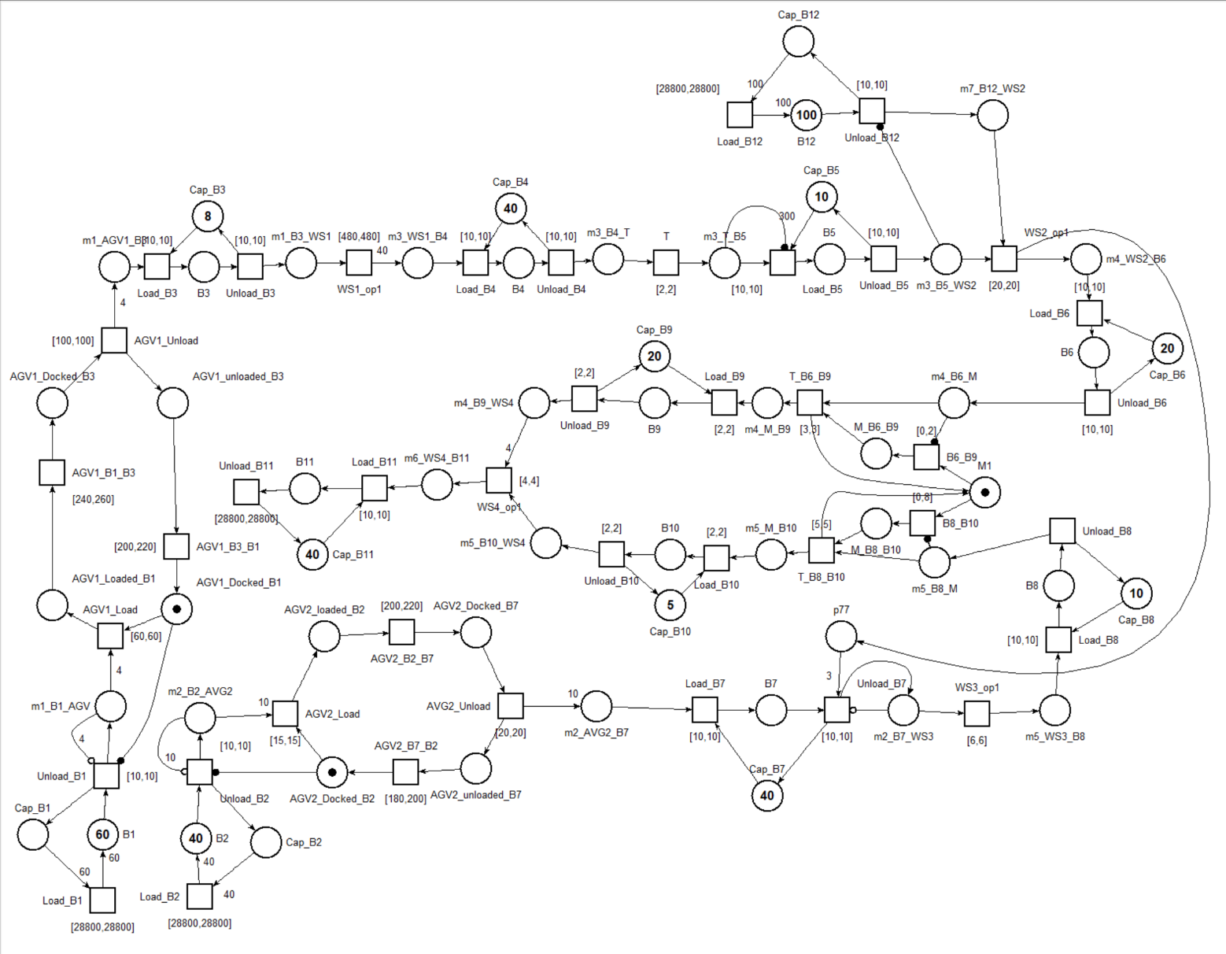
Designing the command and control system

Slide 36
Recap
Introduction to modeling and simulation using Petri Nets | Basic elements: places, transitions , arcs Simulation Modeling concurrency Timed nets Determinism vs stochastic Special arcs
Introduction to modelling and simulation of food manufacturing processes | Modeling processing equipment Modeling transport equipment Modeling control Modeling robots Modeling human perators Modeling a complete manufacturing line Simulating a complete manufacturing line
Introduction to digital design manufacturing processes | Designing the layout Designing the operation of the line Designing the command and control system

